Slide 1
VAXRISK: Analysis of VAERS Reports for Vaccine Safety Assessment
DATA 606 Capstone in Data Science
Under the guidance: Ozgur Ozturk
Presented by:
Chandrikarani Vaidya
Terala Bhuvana Chandrika
Sai Ganesh Donka

Slide 2
TABLE OF CONTENTS
INTRODUCTION
DATA PREPARATION
FEATURE SELECTION
EXPLORATORY DATA ANALYSIS
DATA MODELING AND EVALUATION
CONCLUSION AND FUTURE WORK
VACCINE

Slide 3
INTRODUCTION
Vaccines have long been a cornerstone of public health, preventing millions of illnesses and saving countless lives. However, as vaccination efforts intensify, particularly in response to global health crises like the COVID-19 pandemic, the need for robust vaccine safety monitoring has never been more critical.
Our project, VaxRisk, addresses this need by leveraging advanced data science techniques to analyze adverse events associated with four key vaccines:
Pneumococcal Polysaccharide Vaccine (PPV)
COVID-19 Vaccine
Influenza Vaccine
Varicella Zoster Vaccine
Using data from the Vaccine Adverse Event Reporting System (VAERS), we aim to predict serious adverse events based on individual demographics and health history.

Slide 4
DATA DESCRIPTION
The Vaccine Adverse Event Reporting System (VAERS) is a crucial tool for monitoring vaccine safety in the United States.
Data source: VAERS data link
It consists of 3 CSV files per year, we are taking the data from (2015-2024):
1.VAERSDATA.CSV: Contains demographic and AE information
2. VAERSVAX.CSV: Vaccine-specific data
3. VAERSSYMPTOMS.CSV: Detailed symptom information

Slide 5
DATA PREPARATION
Data Loading and Merging: Loaded VAERS data from CSV files (VAERSDATA, VAERSVAX, VAERSSYMPTOMS) and Merged datasets using 'VAERS_ID' as the key
Handling Missing Values: Dropped rows with NaN values using dropna() and replaced with unknown for columns having many null values.
Encoding Categorical Variables: Applied label encoding for binary variables to convert categorical data into numerical format.
Cleaned text data using regular expressions for consistency and eliminated unnecessary columns to streamline the analysis.
Data Filtering: Focused on specific vaccine types (COVID, VARZOS, FLU, PPV). Also filtered data from the years 2015 to 2024

Slide 6
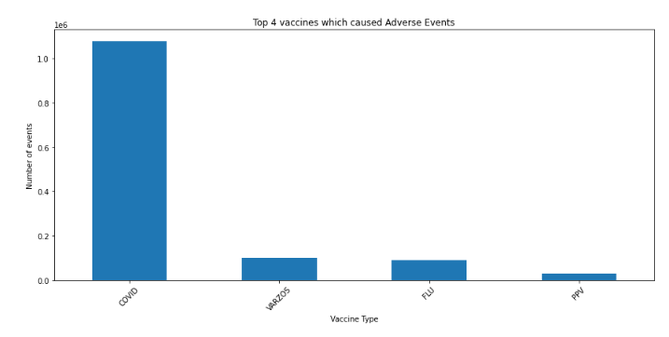
What data are we working on?
Time Frame: Analyzed data from 2015 to 2024.
Focus Area: Concentrated on the number of adverse event reports related to vaccines.
Vaccine Selection: Identified 4 vaccines with the highest number of reported adverse events.
Conducted detailed analyses for each of the selected vaccines.

Slide 7
FEATURE SELECTION
Target Variable Creation- Defining Serious Criteria
1. Death
2. Life Threatening
3.Hospitalization
Is the patient died?
Is the adverse event life threatening?
Is the patient Hospitalised?
4. Disability or Permanent Damage
5. Birth Defect
6. Other Important Medical Terms
Did the patient have any birth defect?
Does the adverse event lead to patient death?
Are the symptoms matching with any IME terms?

Slide 8
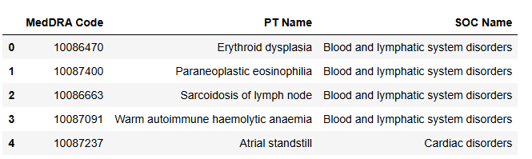
Important medical Events List
The MedDRA Important Medical Event (IME) Terms List is a curated subset of the Medical Dictionary for Regulatory Activities (MedDRA), used for coding adverse events in healthcare and pharmaceuticals.
In our analysis, we focused on two levels: Preferred Terms (PTs) and System Organ Classes (SOCs). We compared columns Symptoms 1 to Symptoms 5 from our dataset with the IME List, creating a derived IME column with:
0: No match with MedDRA terms
1: Match found with MedDRA terms

Slide 9
Flowchart for target variable
DIED
L_THREAT
BIRTH_DEFECT
HOSPITAL
DISABLE
TARGET VARIABLE
“SERIOUS”
IME
SERIOUS
SYMPTOM 1
SYMPTOM 2
SYMPTOM 3
SYMPTOM 4
SYMPTOM 5

Slide 10

EXPLORATORY DATA ANALYSIS

Slide 11
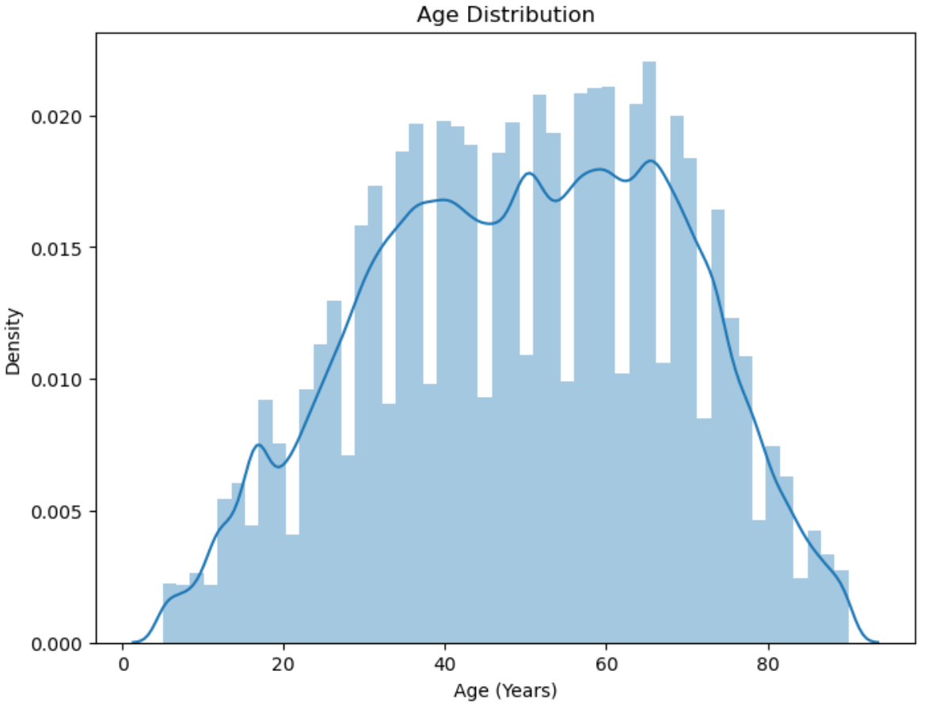
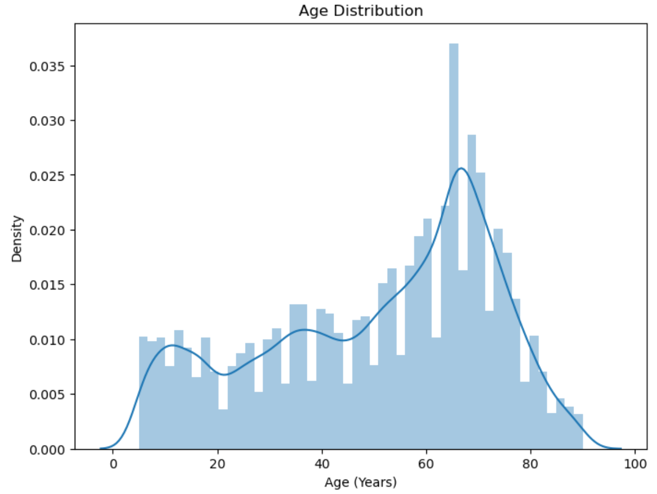
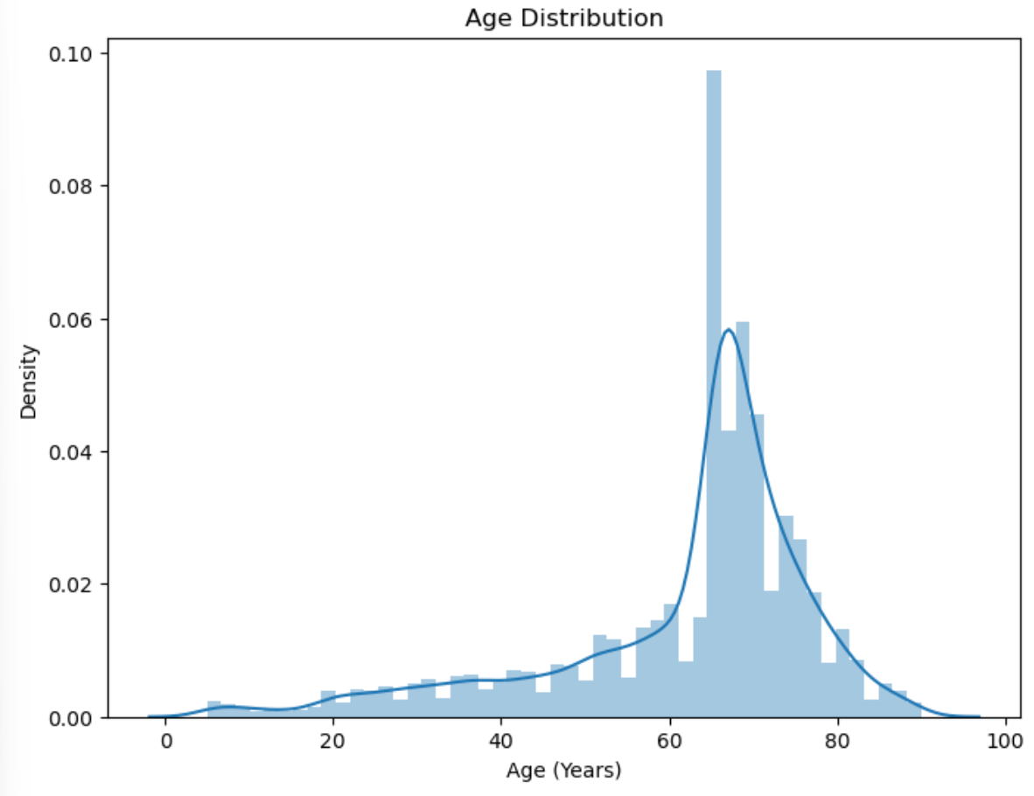
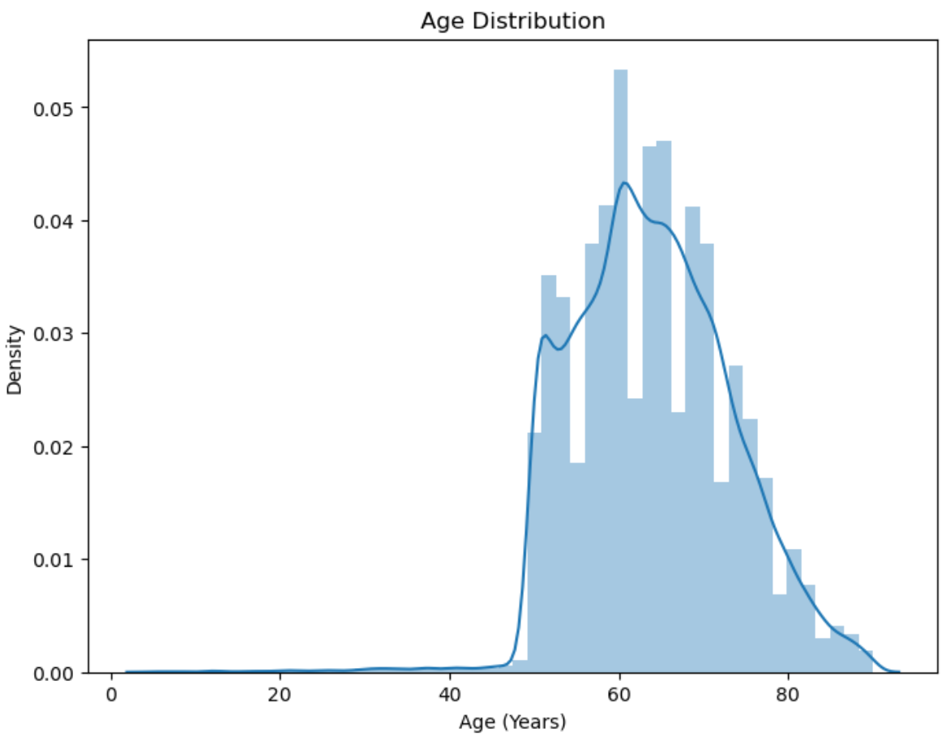
AGE DISTRIBUTION
COVID
FLU
PPV
VARZOS

Slide 12
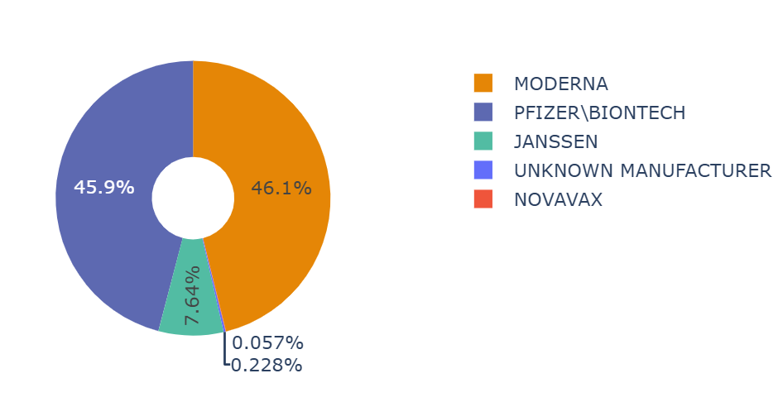
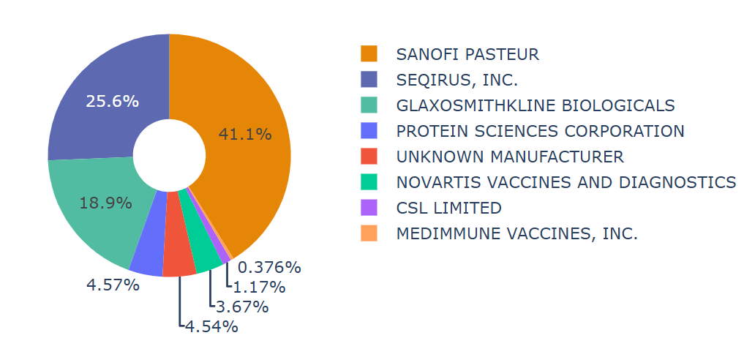
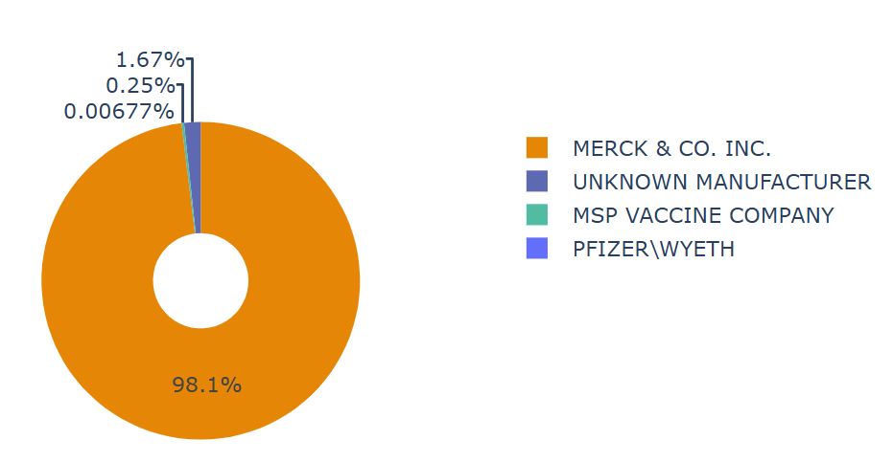
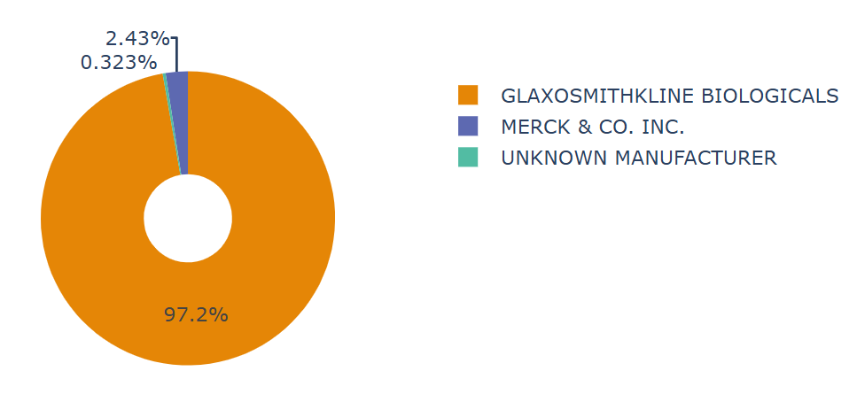
VACCINE MANUFACTURERS
COVID
FLU
PPV
VARZOS

Slide 13
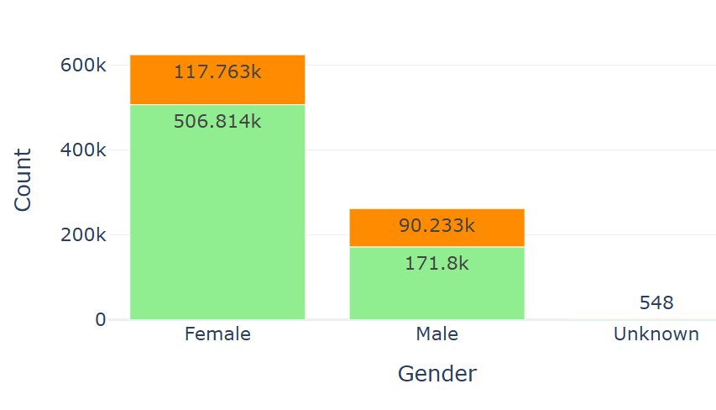
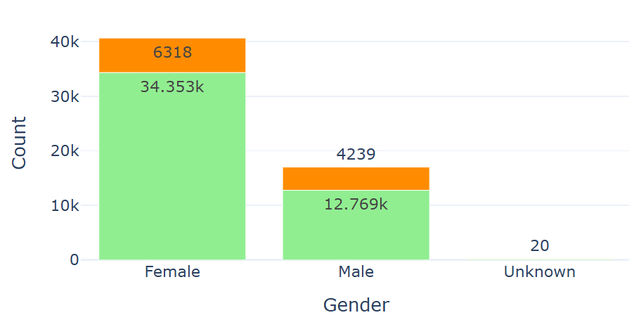
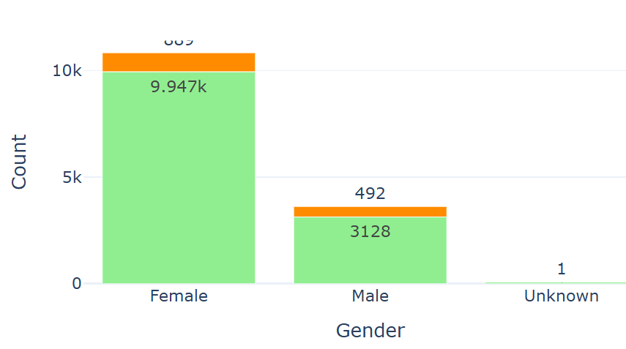
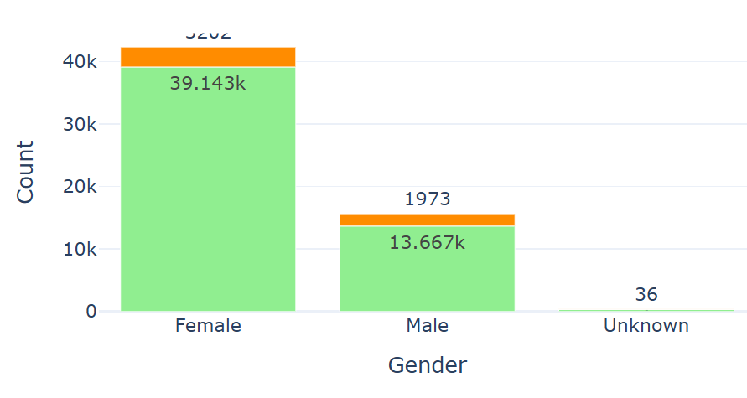
SERIOUSNESS WITH GENDER
COVID
FLU
PPV
VARZOS

Slide 14
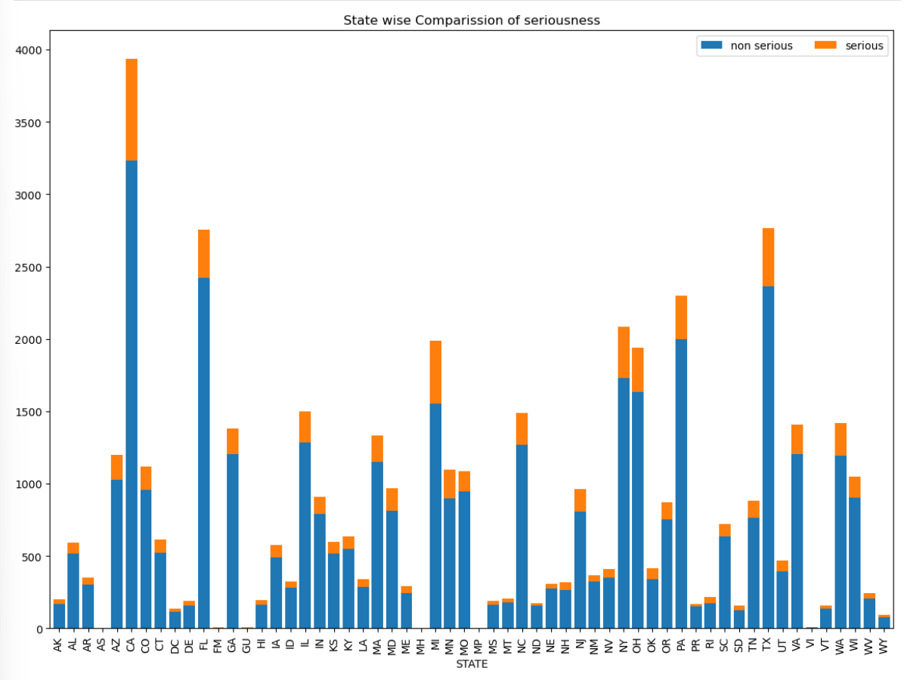
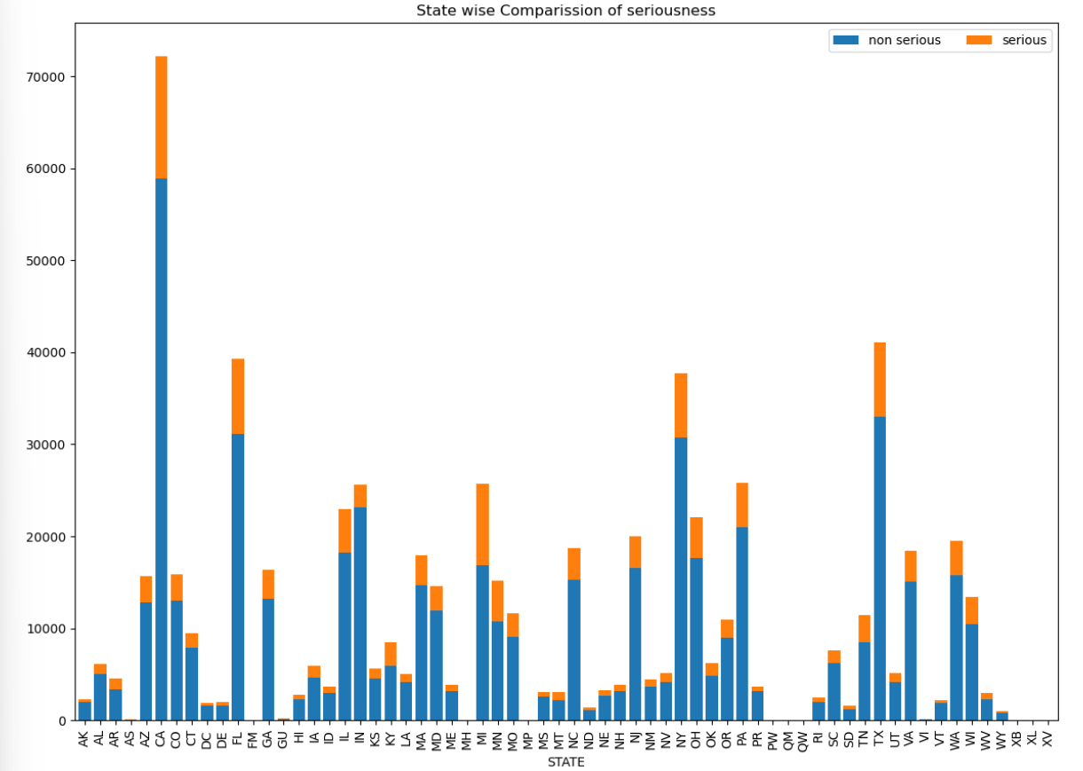
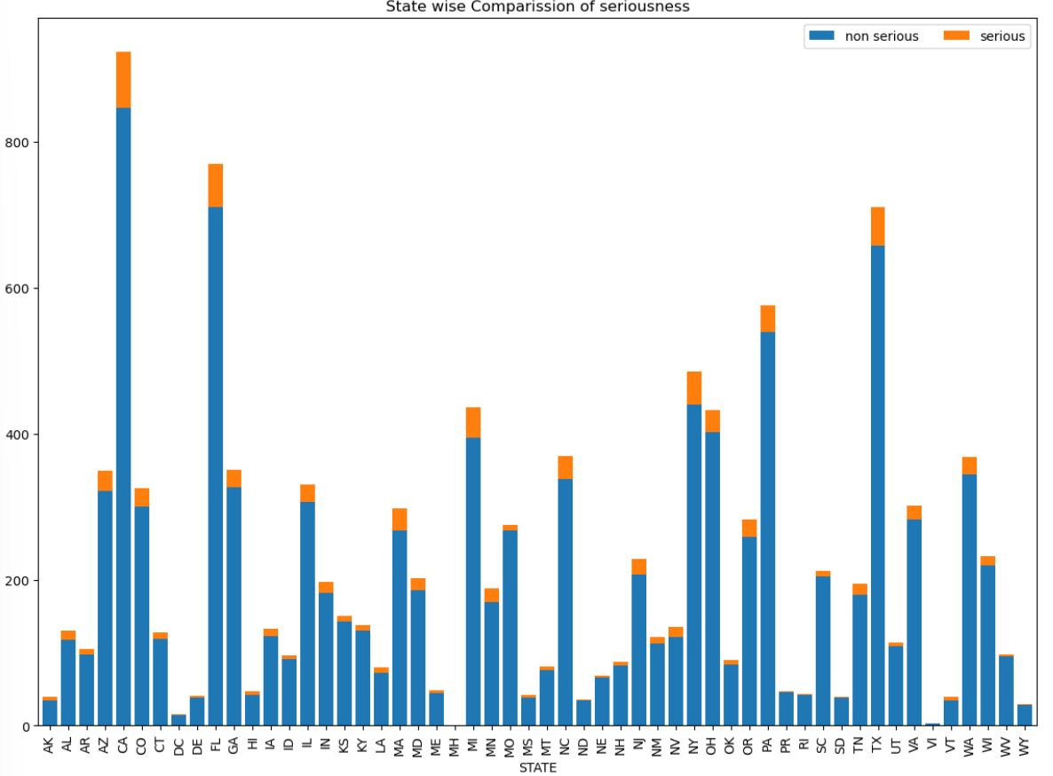
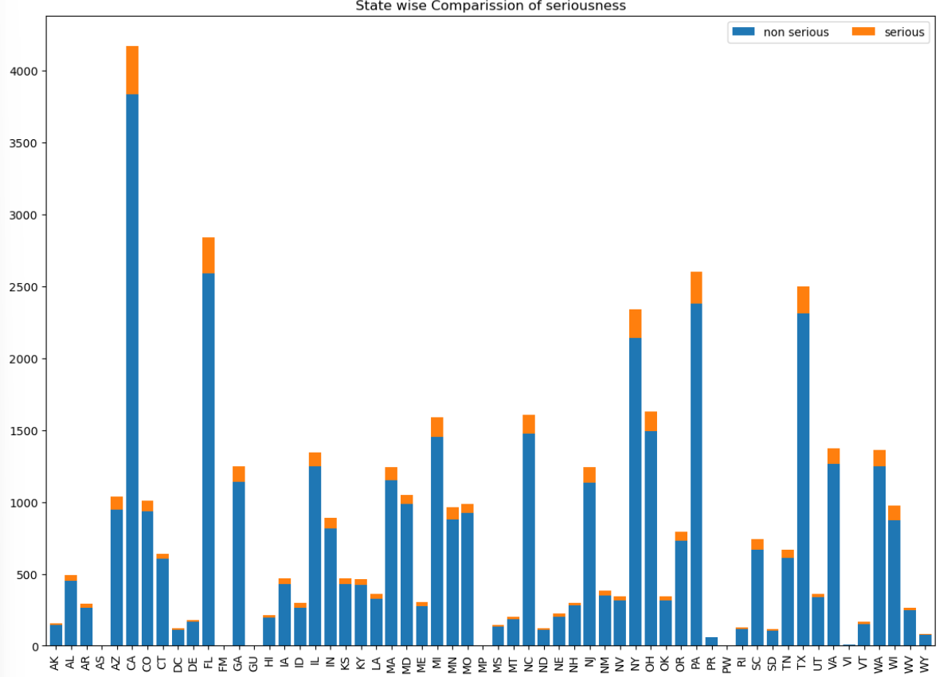
STATE-WISE SERIOUSNESS
COVID
FLU
VARZOS
PPV

Slide 15
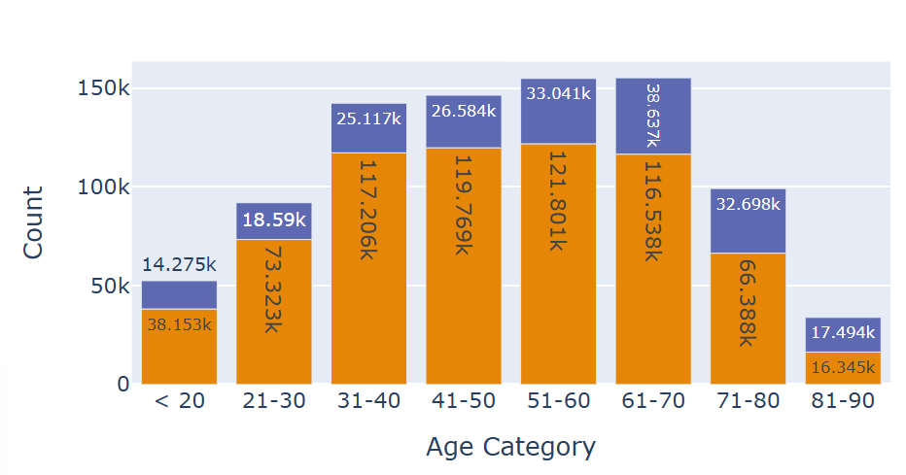
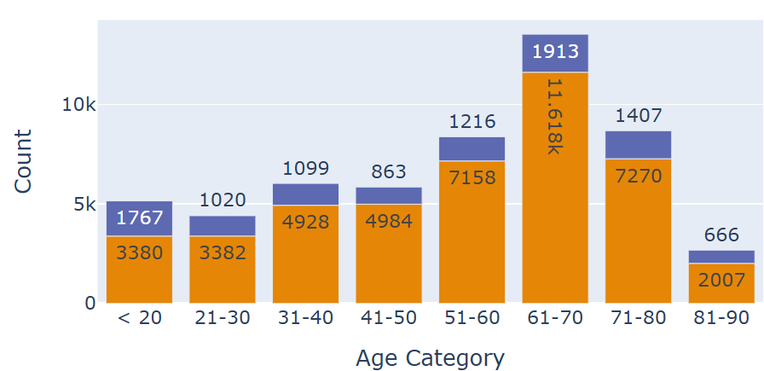
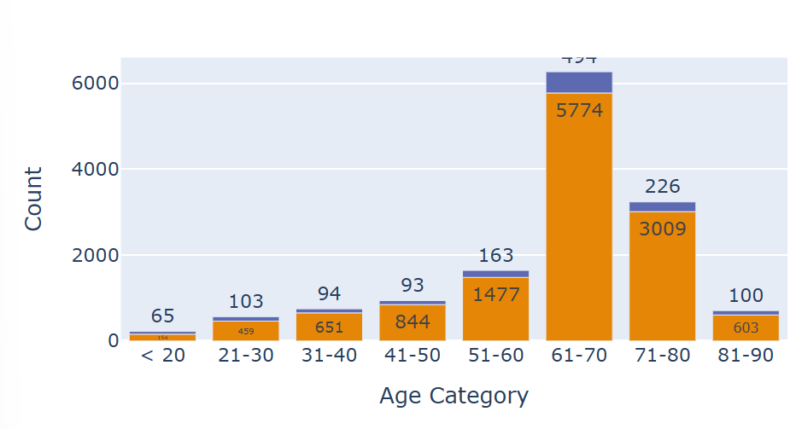
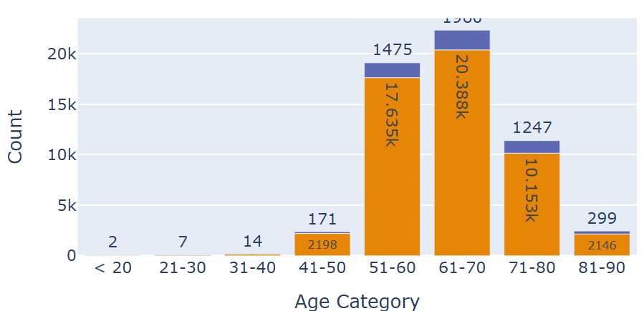
SERIOUSNESS WITH AGE GROUPS
COVID
FLU
VARZOS
PPV

Slide 16
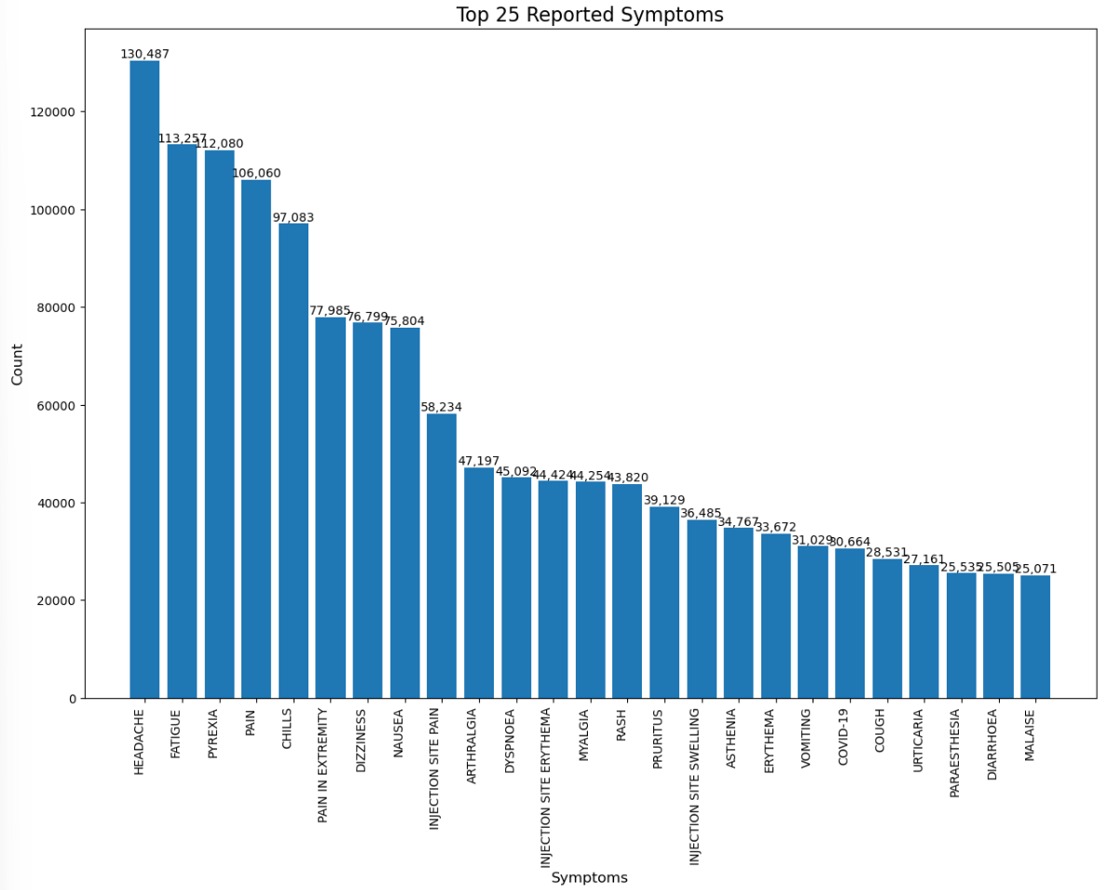
TOP 25 REPORTED SYMPTOMS

Slide 17
DATA MODELING

Slide 18



MACHINE LEARNING MODEL DEVELOPMENT
Objective: Build a predictive model to classify adverse vaccine events as "serious" or "non-serious.“
Challenges: Data Imbalances such as fewer serious cases compared to non-serious ones.
Mixed Data Types: Text columns (symptom descriptions, medical history) and numeric columns (age, hospitalization status).
Vectorizer
Pipeline with ML
Split Data
Evaluation
For Textual columns, we applied TFIDF Vectorizer
Created pipeline with ML algorithms and vectorizer

Slide 19
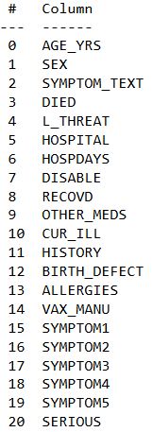
Train and Test Split
70%
30%
Train
Test
# Defining variables
Y = df.SERIOUS
X = df.drop(['SERIOUS','SYMPTOM1','SYMPTOM2’,
'SYMPTOM3','SYMPTOM4', 'SYMPTOM5','VAX_MANU'], axis=1)

Slide 20
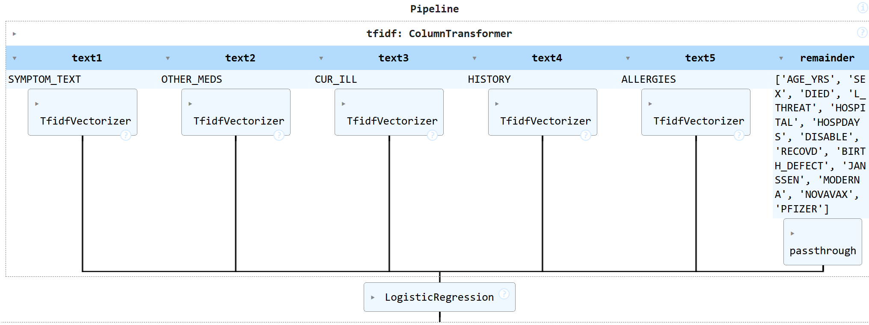
Pipeline For TFIDF
Used TF-IDF (Term Frequency-Inverse Document Frequency) to convert text fields into numeric features.
Used StandardScaler to normalize numeric columns for model compatibility.
Custom stopwords added to remove irrelevant terms (e.g., "vaccine," "patient").

Slide 21
Machine Learning Models
Logistic Regression
Random Forest Classifier
ADABoost Classifier
K Nearest Neighbors

Slide 22
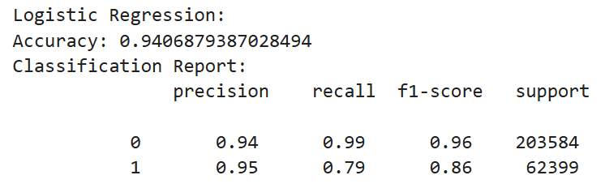
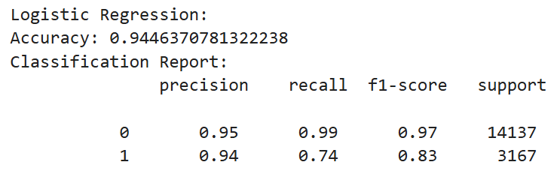
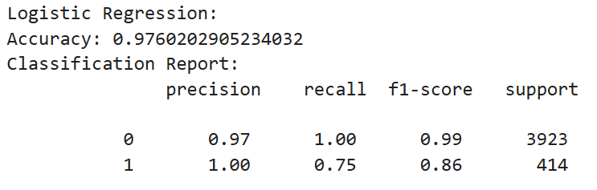
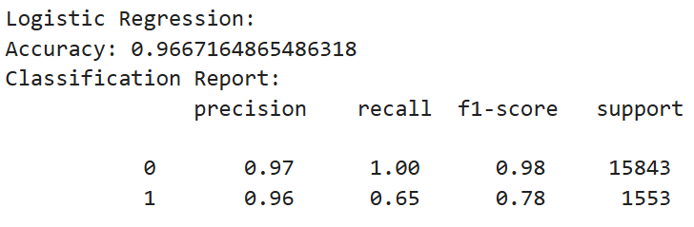
MODEL EVALUATION
COVID
FLU
PPV
VARZOS

Slide 23
CONCLUSION
Key Takeaways:
• Filtered and analyzed four vaccine datasets from VAERS reports using Logistic Regression.
• Achieved high accuracy, indicating strong initial predictive performance.
Next Steps:
• Implement additional machine learning algorithms to further improve outcomes.
• Apply SMOTE to address data imbalance and enhance model reliability.
• Compare accuracies to identify the most effective predictive approach for vaccine analysis.
Goal:
Refine and optimize our models for more accurate and comprehensive vaccine outcome predictions.

Slide 24



FUTURE WORK
Creating a user interface would aid healthcare professionals in screening AE reports for seriousness and help patients understand symptoms before vaccination
We will be creating the user interface where people enter their Vaccination details, age, health conditions etc and it predicts the seriousness of vaccine.

Slide 25
THANKS!!

